Slide 1
Documentation management and version control
By – kanaga Manikandan Solaikannan

Slide 2
What are they?
Documentation Management is a method used to preserve the files in an external storage where it’s secure and accessible by other team members.
Version Control keeps track of all the modifications performed by the team and will allow you to go back to a certain point in development and start afresh.
We’ll be covering how documentation management and version control were used to support the management of the software development exercise.
Notes:
Before 2nd point - One such technique is Version Control. Click
After 2nd point – start afresh if any problems were to rise. There are more benefits in using Version Control and that’s what ‘Click’ for 3rd point

Slide 3

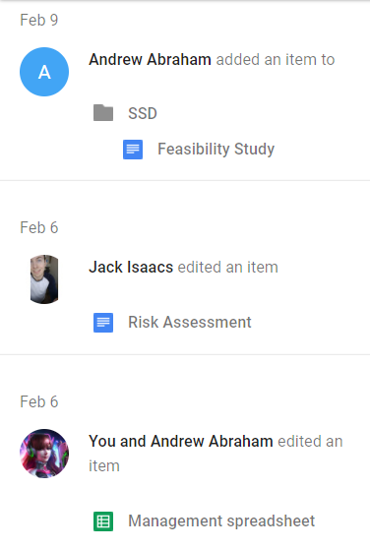
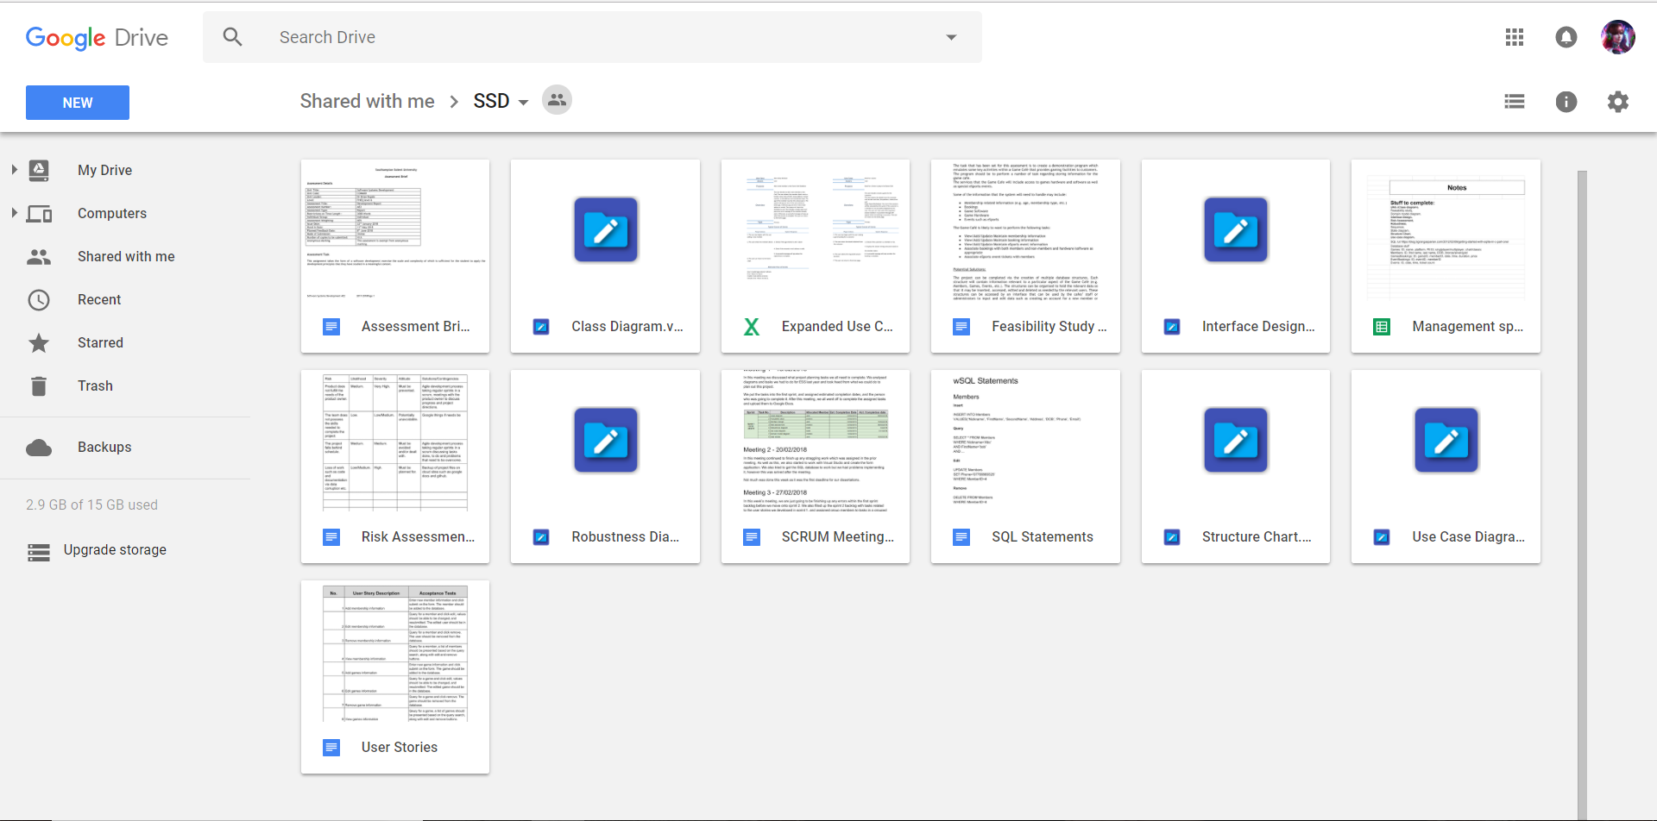
how were the documents managed?
Google Drive was used to securely store the files and it allowed the team to access them anytime.
It allowed the team to make any changes to the files freely or work together to make spontaneous changes.
Notifications about changes made in the documents allowed the team to be up to date with the progress.

Slide 4
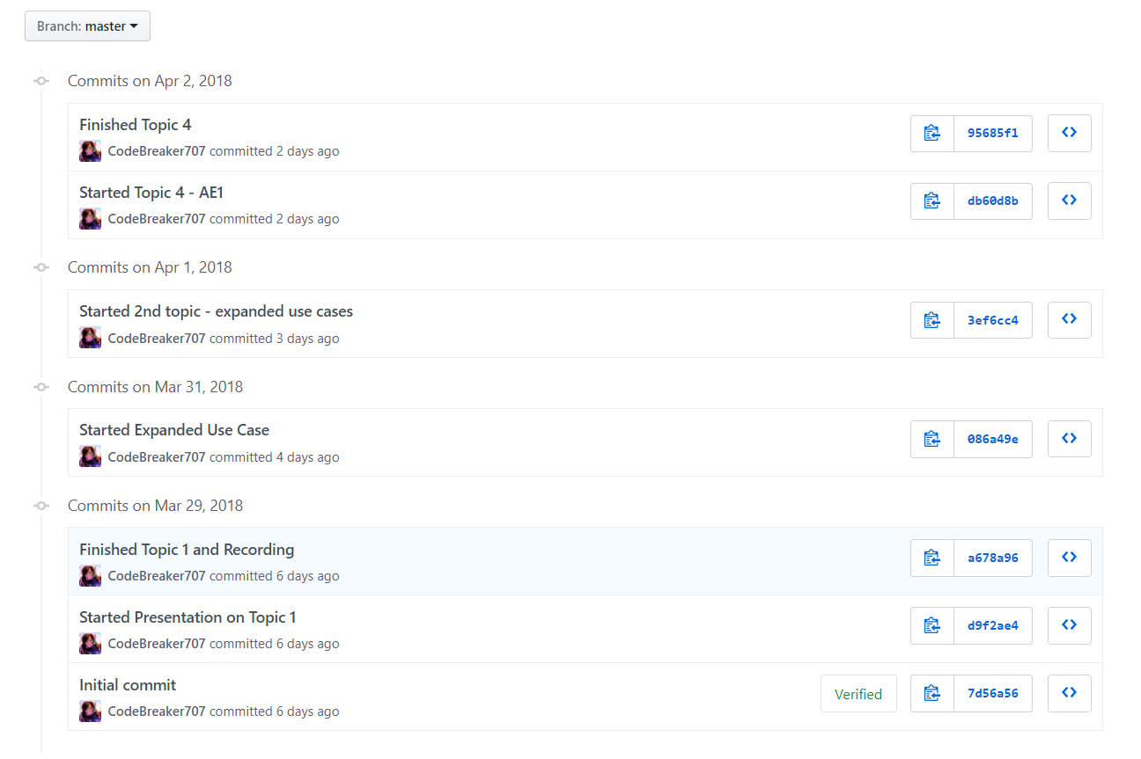
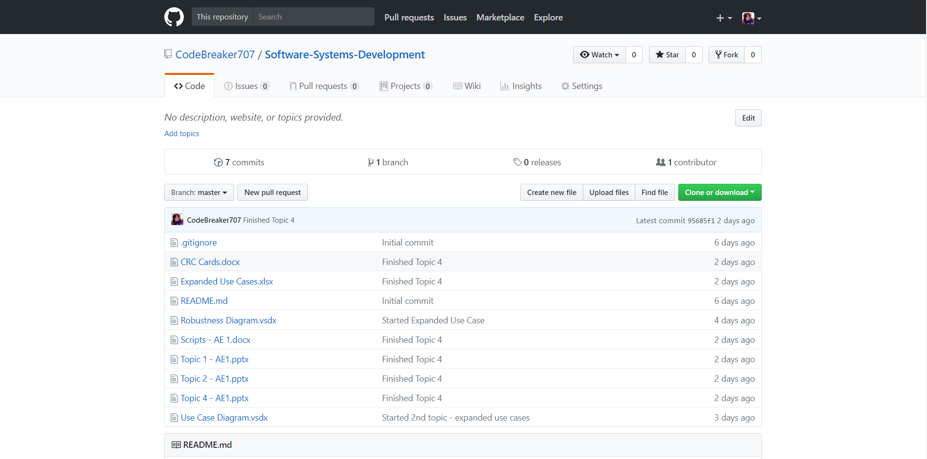
How was version control helpful?
GitHub was another software used to securely store the files in an online storage.
It allowed the team to keep track of all the updates performed through the course of the development.
It proved better than Google Drive in terms of uploading and accessibility.
Notes:
3rd point – why better at uploading because Google drive cannot not know what changes have you made unless you uploaded them where as in GitHub, you can make any changes in the desktop and it will keep note of all changes and all you had to do was ‘commit changes and push it to the online storage’.

Slide 5
How did it pay off?
The tools supported the team very well as they made communication easier and were very easy to use.
They also proved to be very reliable and cost-efficient.
The tools supported our Agile development methods in a better way as they allowed us to work together on a single document and discuss about it at the same time.

Slide 6
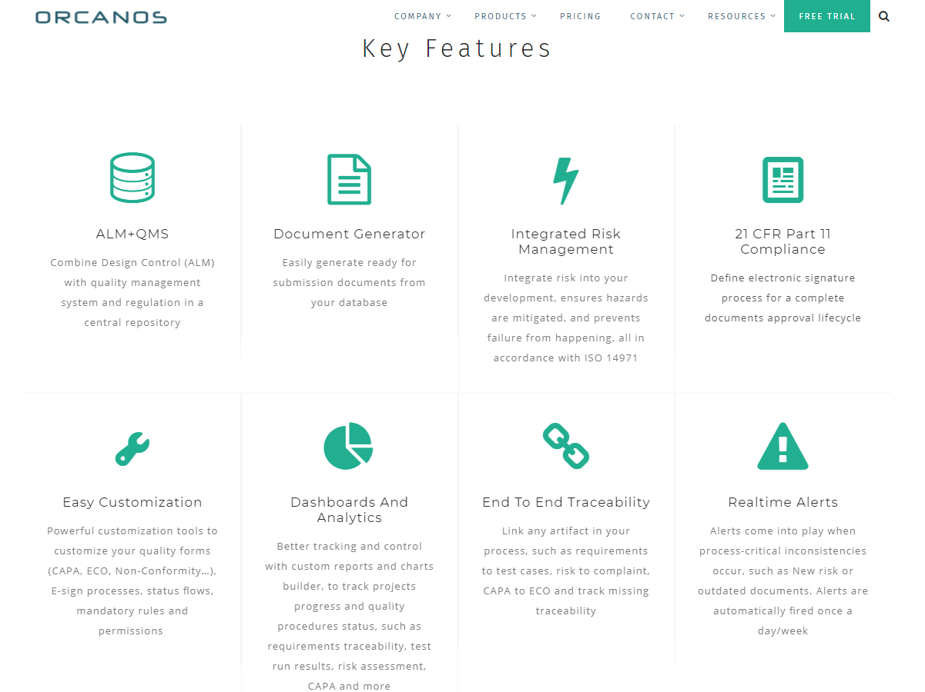

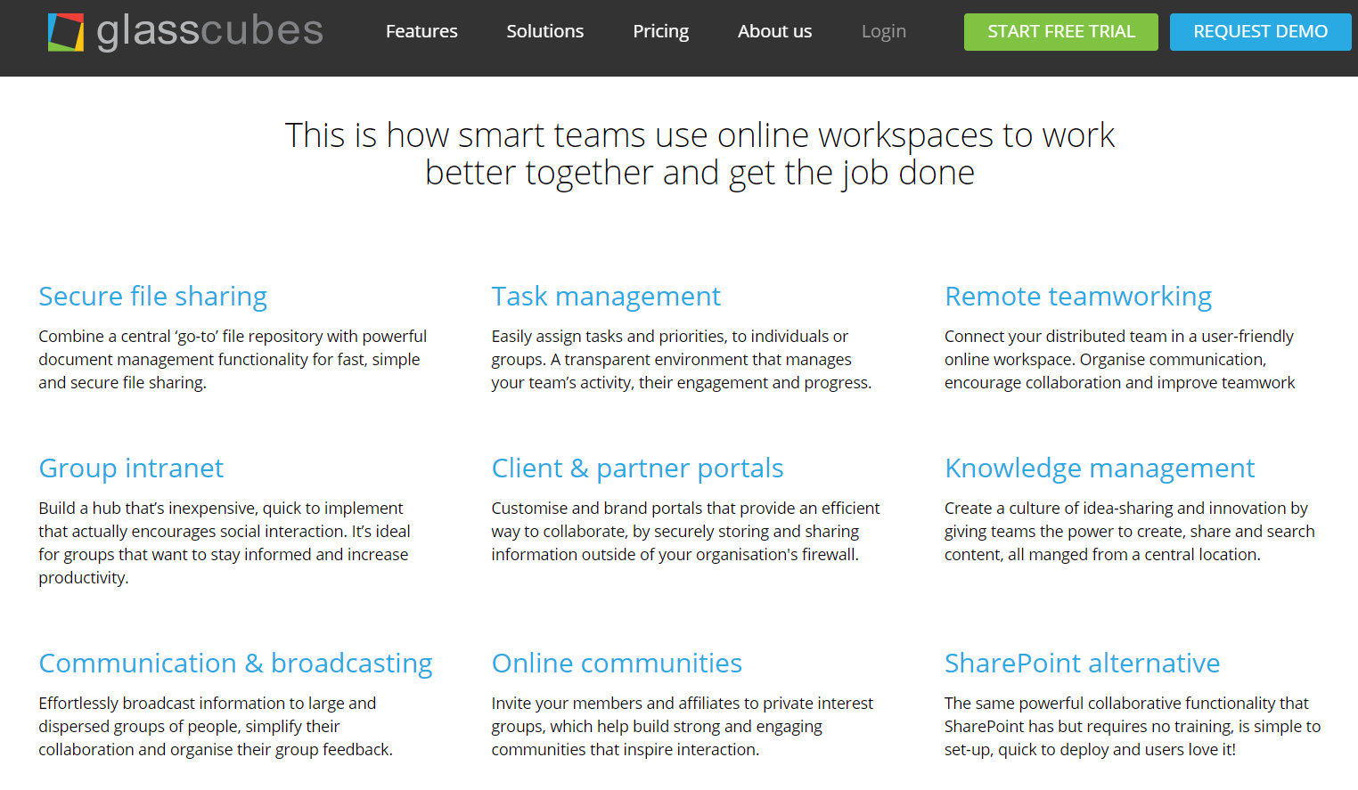
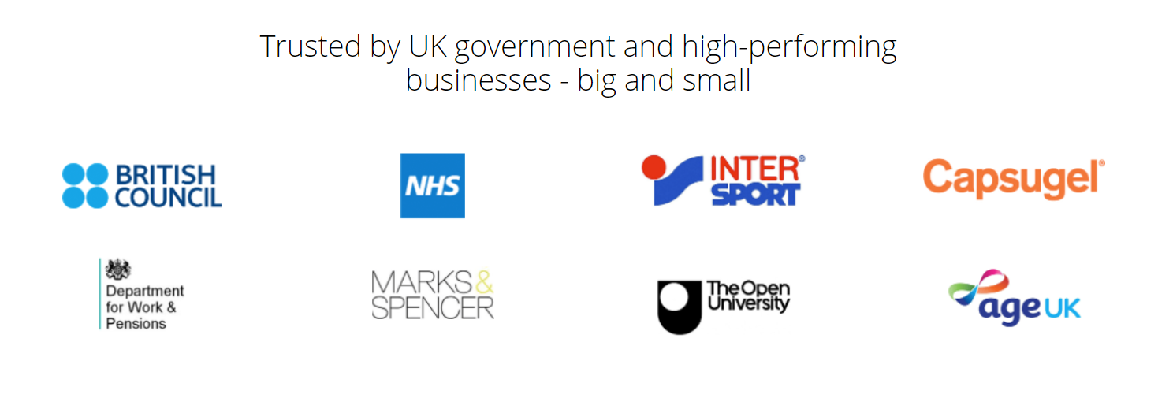
What else can be done?
There are other software products available online which offer more features.
Some of them are Orcanos, Glasscubes and PandaDoc. They seem to offer a number of features on group collaboration, task management, security, etc.
They even seemed to be used by a lot of prestigious companies.

Slide 7
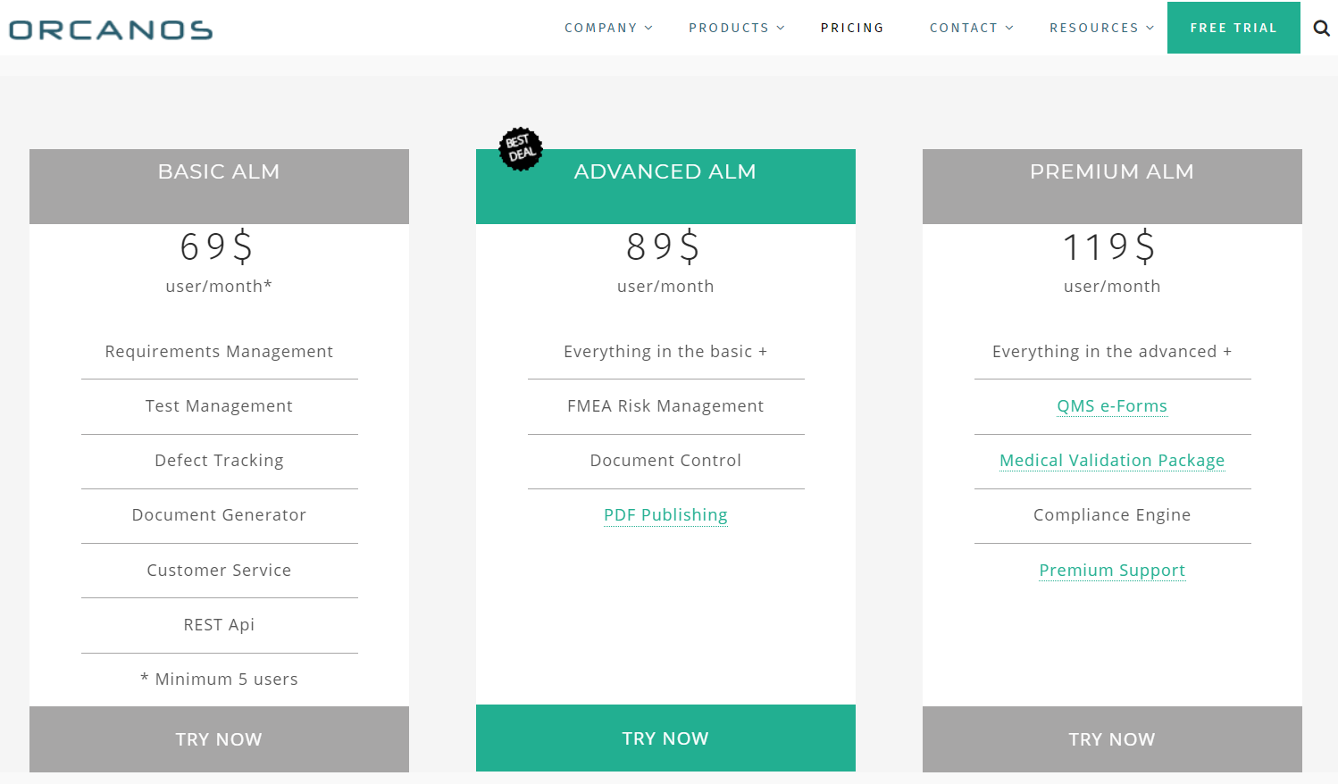
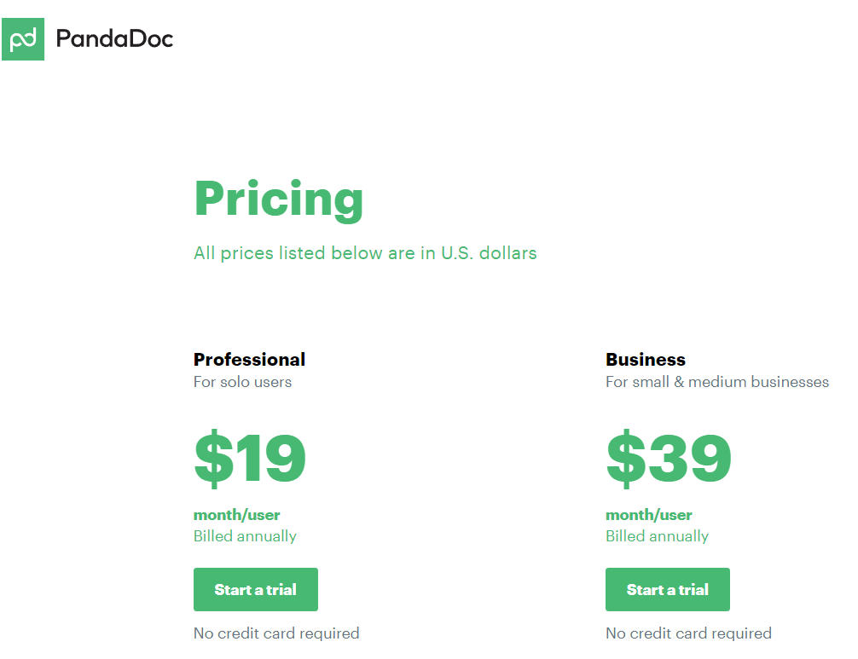
Why were these not chosen?
One of the reasons is that these software products are priced by subscriptions.
The other reason is that, the features they provide weren’t necessary for our project.
Even if the above conditions were favourable to the team, the team members could not afford to pay for such services.
Notes:
1st point – Some thought could have been given if they were available in a single payment.
2nd point – It is a team of 3 and the software we’re producing in the end is not large-scale
Thus, the team decided to use software products that were free and provided all the necessary benefits.

Slide 8
references
http://www.aiim.org/What-Is-Document-Imaging#
https://www.atlassian.com/git/tutorials/what-is-version-control

